Slide 1
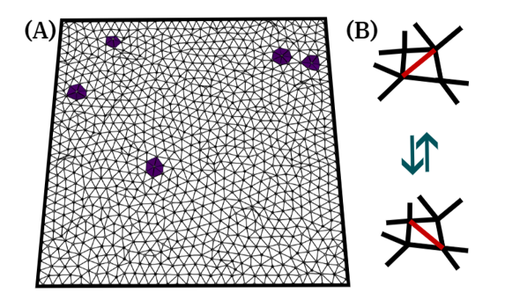
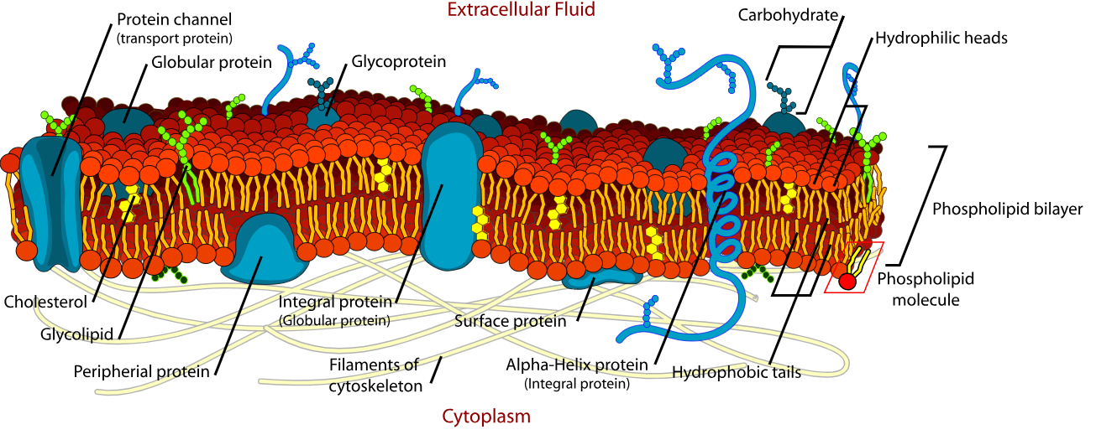
Plasma Membrane through the lens of theoretical physics
Dhrubaditya (Dhruba) Mitra
NORDITA, Stockholm

Slide 2
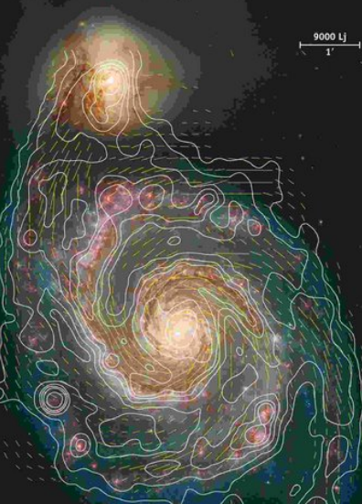
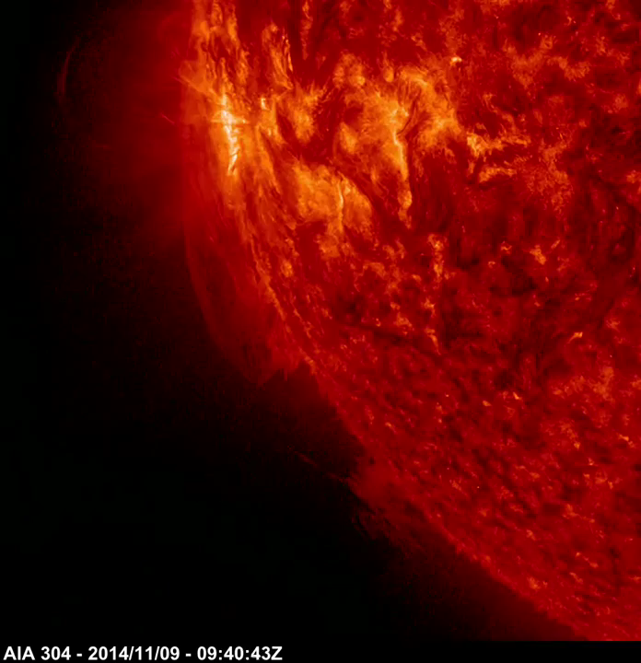

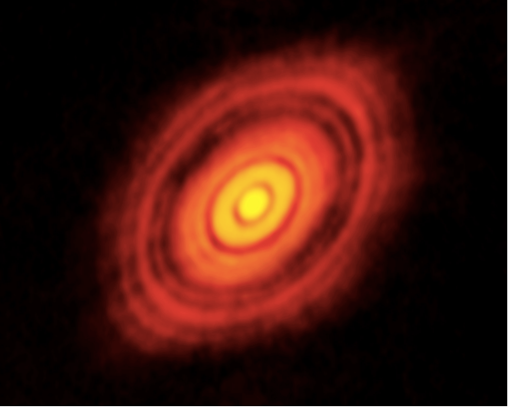
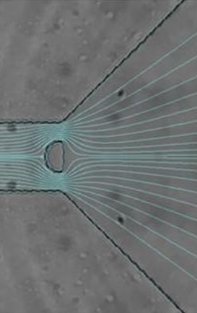


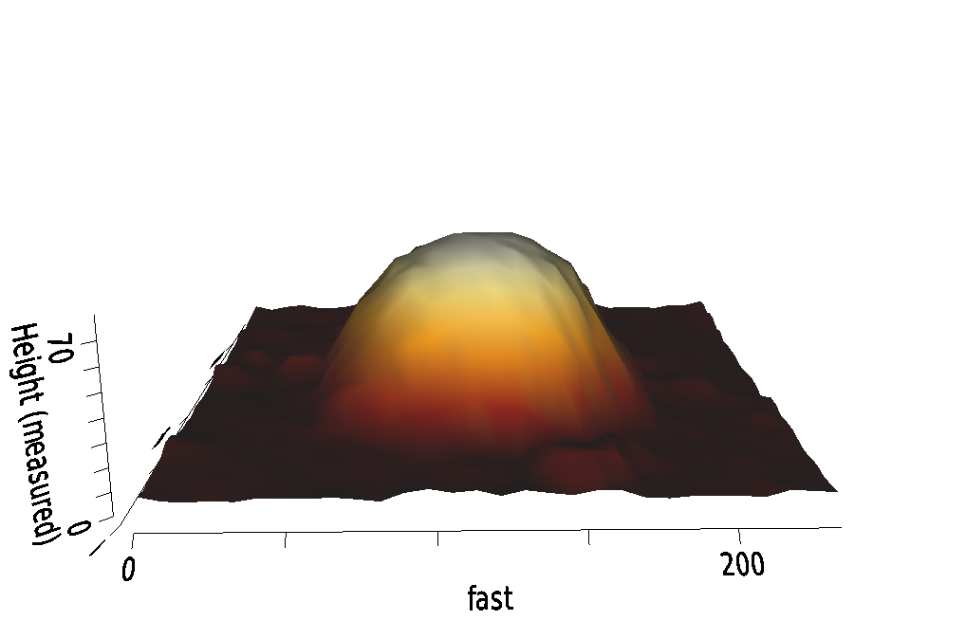
GALAXY Accretion disk Sun Ocean
mega-parsec 100 AU 1000 Mm 100 m
10 m mm micrometer 100 nm
Laboratory Dew drops Red Blood Cell exosomes

Slide 3

Conclusion
Physics over a very large range of scale is “effective theory “ in the sense that they are coarse grained phenomena from microscopic theory – generalized hydrodynamics and elasticity.
Typically nonlinearities play crucial role – all the beauty of universe are nonlinear.
These are typically inaccessible to exact solutions.
Linearized and weakly nonlinear theories are tractable, sometime with great difficulty.
We construct asymptotic perturbation theories – often it is very difficult to identify a small parameter.
Real progress happens when massive numerical simulations are coupled with careful theory.

Slide 4
Cell membrane
Image credit : Wikipedia, Mariana Luiz
Cell size – micrometer
Membrane thickness – 5 nm
Bilipid layer with proteins. Some of the protiens are bigger than the thickness of the membrane.
The proteins are attached to a cytoskeleton below.
Cetoskeleton is made of actin polymers.

Slide 5
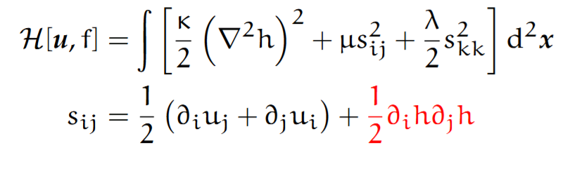
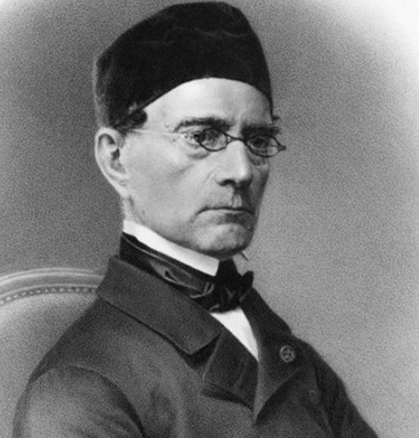
(Thin) Plates : 2d elastic material embedded in 3d
z
y
f
u
x
Gabriel Lame

Slide 6
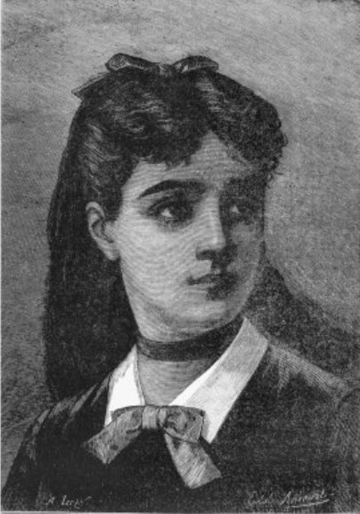
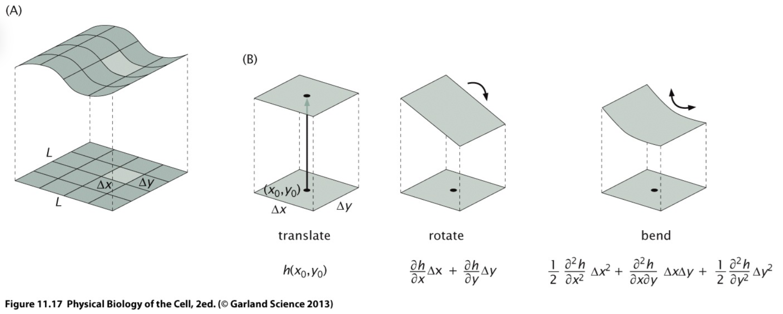
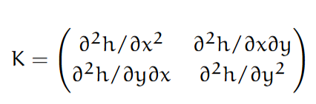
(Thin) Plates : 2d elastic material embedded in 3d
z
y
f
u
x
Sophie Germain

Slide 7
(Thin) Plates : 2d elastic material embedded in 3d
z
y
f
u
x
Sophie Germain
Gabriel Lame

Slide 8
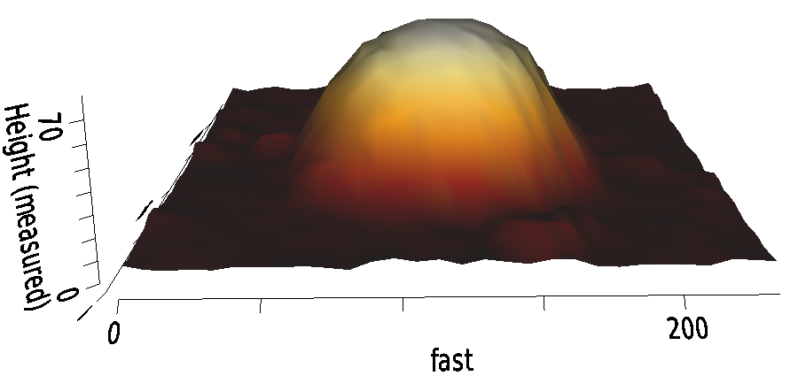
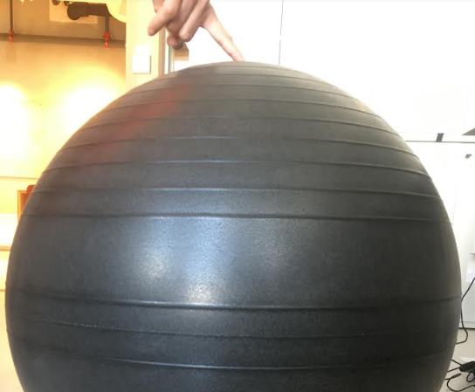
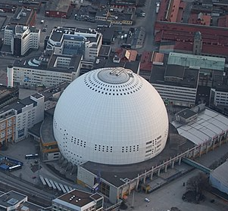
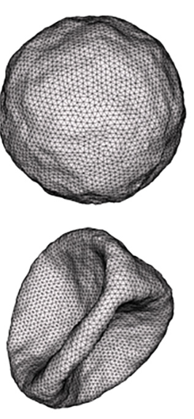
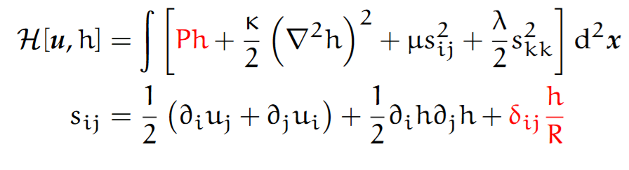
Thin Shells
AFM image of exosome, Apurba’s lab 100 nm
Avici arena, Stockholm
100 m
Exercise ball, Vipin’s office1 m

Slide 9
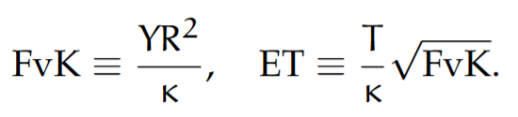
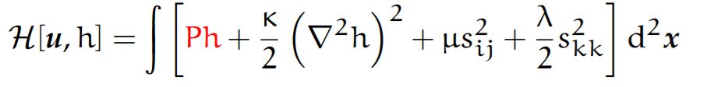

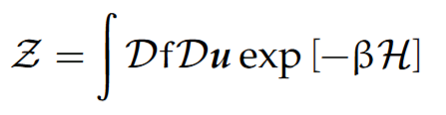
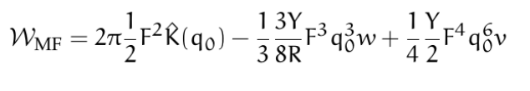
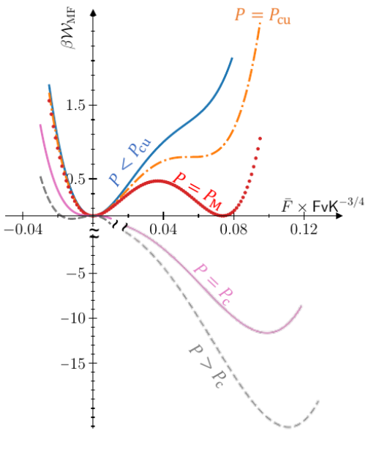
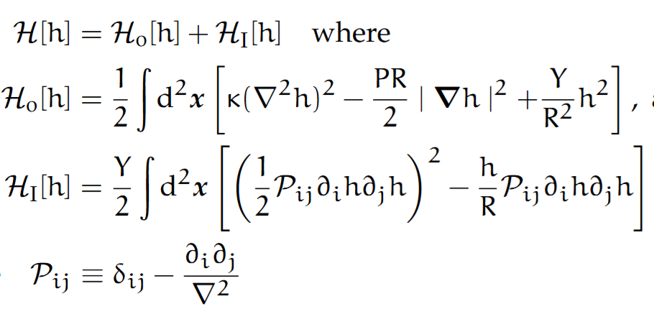
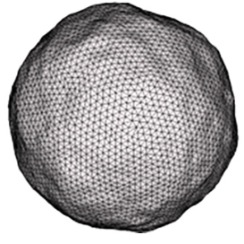
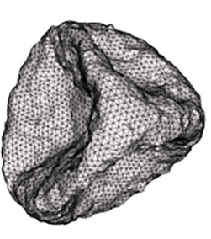
Theory of Buckling

Slide 10
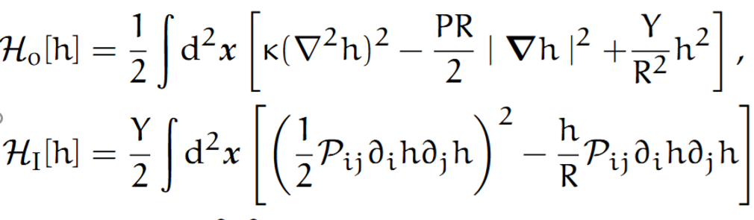
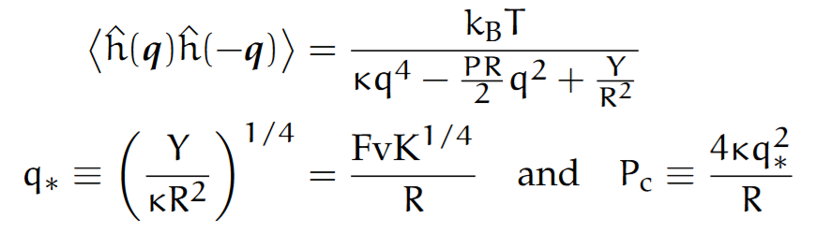
Theory of Buckling

Slide 11
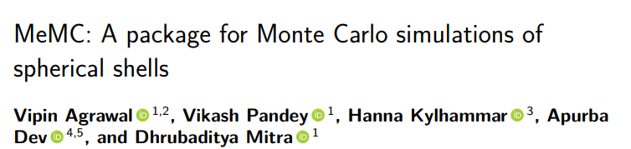
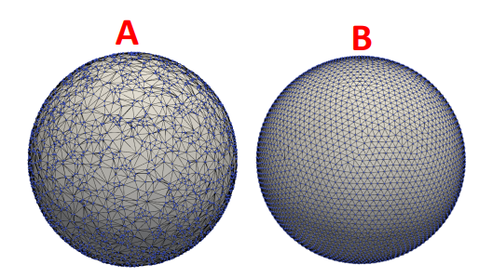
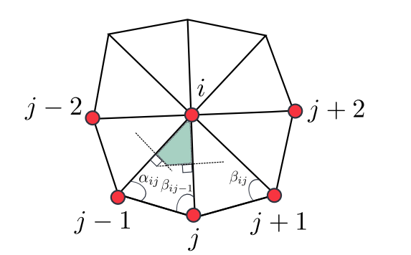

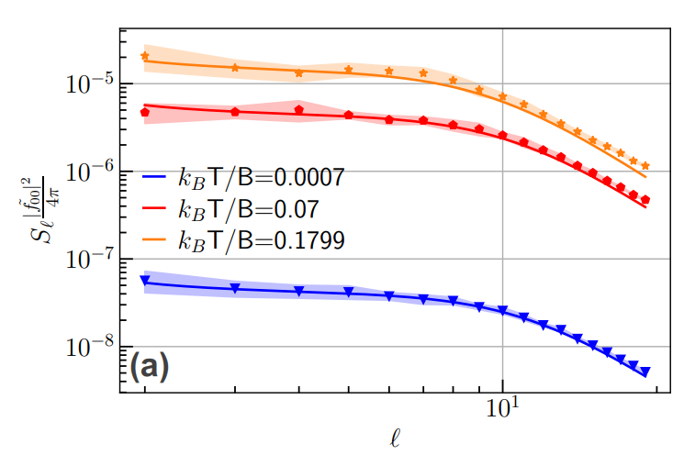
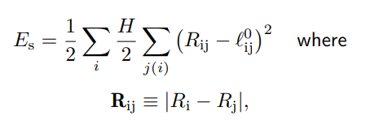
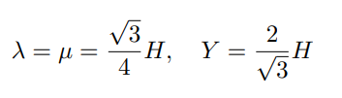
Monte carlo for spherical shells

Slide 12
Buckling by the wheel of theoretical physics.
symmetry, stability, differential geometry
Nonlinear elasticity of shells
Monte Carlo
Mean-field
theory
Buckling
Linear
elasticity

Slide 13
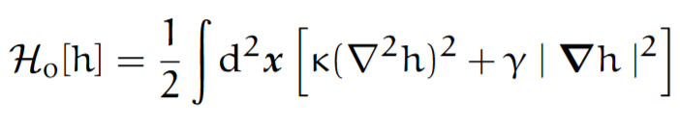
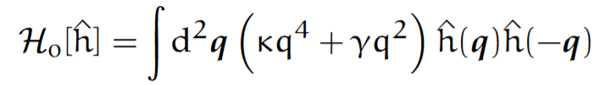
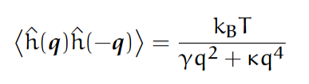
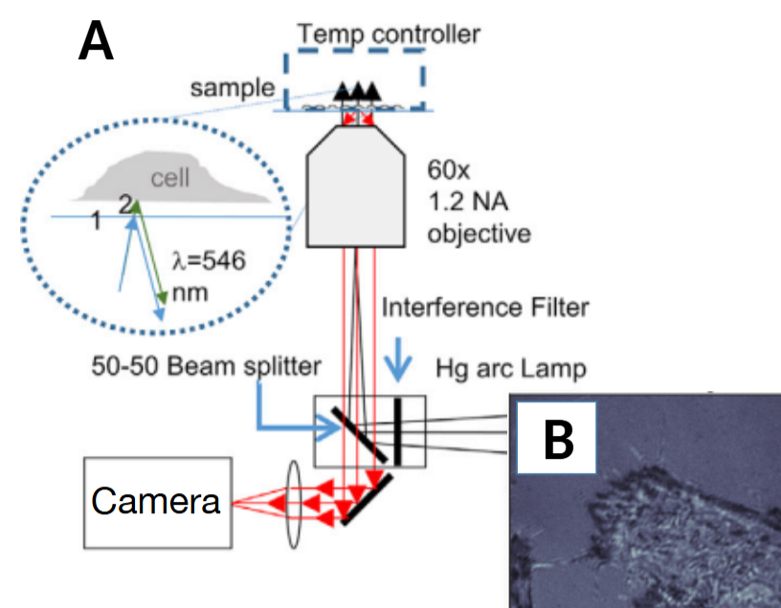

But biomembranes are fluid & active
Fluid → Zero in-plane shear modulus.
Measure the elastic parameters by Interference reflection microscopy, flickering.
But the relationship assumes thermal equilibrium which the membrane is not in -- R. Blowers, E. M. Clarkson, and M. Maizels,(1951)
The fundamental property of living cells is that they are not in thermal equilibrium even when they are statistically stationary – they consume energy and generate entropy.
How to quantify their non-equilibrium nature ?
How much their physical properties are affected by the fact that they are not in equilibrium ?
B Sinha, IISER-K

Slide 14
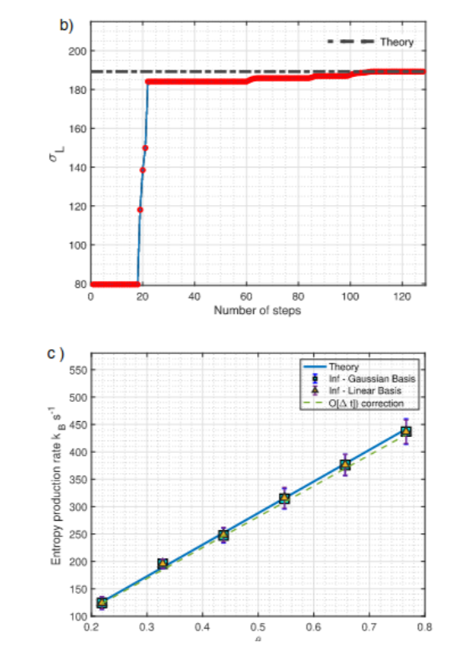
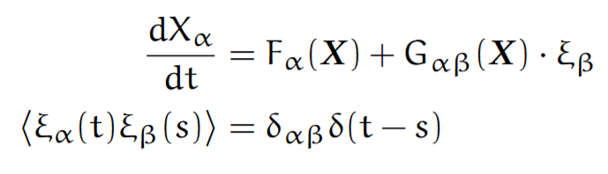
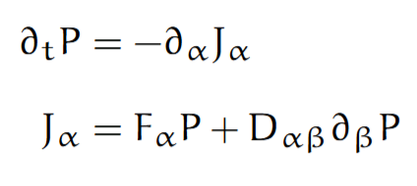
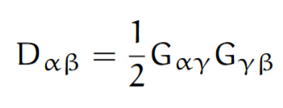
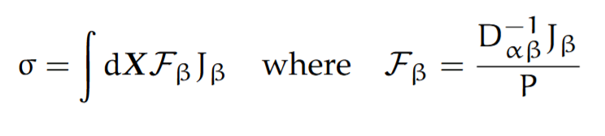
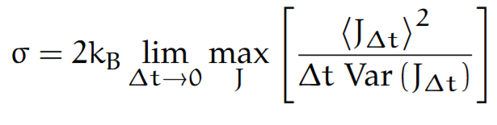
Inverse Fokker—Planck & Entropy Production Rate
Manikandan et al Communications Physics 2021
The flicker data is a Langvein problem in d dimension.
Every Langvein ←→ Fokker—Planck Eqn.
Can we infer drift & diffusion from data ? And calculate entropy production rate ? Use tools from stochastic thermodynamics.
Less ambitious : set bounds to entropy production rate from data.
Reformulate as an optimisation problem.
We apply a short—time scheme to expt. data for “shaken parabola” → excellent agreement

Slide 15
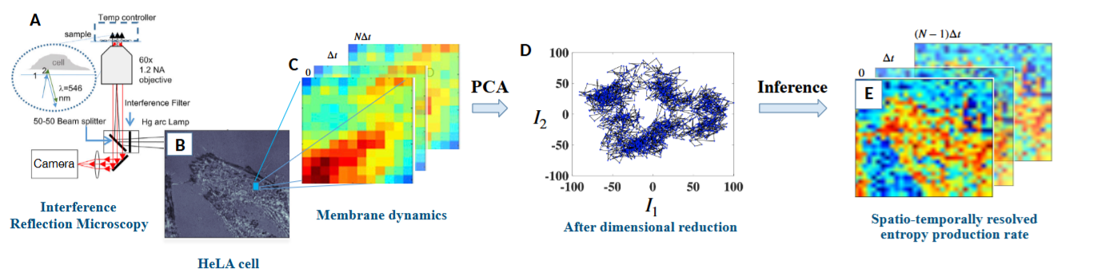
How far from equilibrium is flicker data ?
Estimate of entropy generation rate can spatiotemporally resolve the active nature of cell flickering , Physical Review Research 2024, S.M Manikandan et al

Slide 16
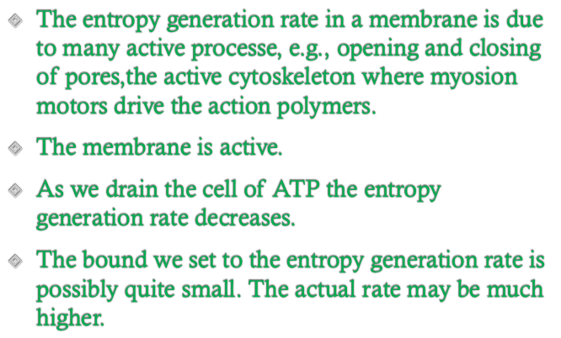
How far from equilibrium is flicker data ?
Estimate of entropy generation rate can spatiotemporally resolve the active nature of cell flickering , Physical Review Research, S.M Manikandan et al

Slide 17
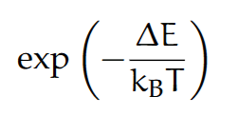
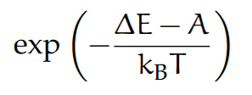
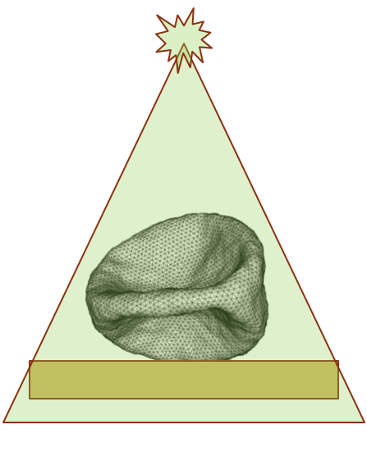
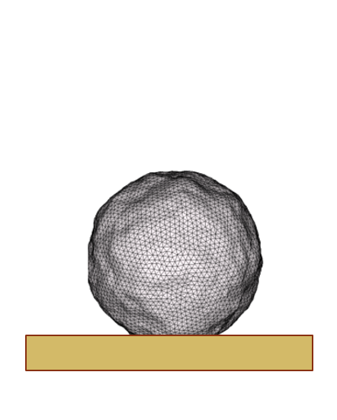
Active Buckling
Metropolis
Non-Equilibrium
A “solid” & active shell.
Go out of equilibrium in a Monte Carlo code that explicitly breaks detailed balance.
The critical buckling pressure changes. Larger active fluctuations lowers buckling pressure.
Make a shell with bacteriorodopsin which can be made active with laser → precisely control buckling of shell in microscopic scale. The membrane similar to cell membranes.
No theory at the moment.
Agrawal, Pandey & DM PRE (L) 2023

Slide 18
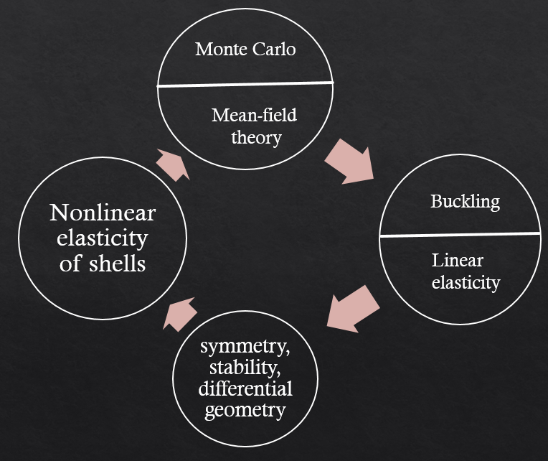

Two turns of the wheel
Active Monte-Carlo Code
Data of IRM Experiments
Measurement of Entropy generation rate
Nonlinear & Active elasticity of shells
Active Buckling

Slide 19





Back to Biomembranes
Experimental model systems : Giant Unilamellar Vesicles
GPMV : Giant plasma membrane vesicles generated using cells.
The membranes themselves are very complex systems.
Different amount and types of lipids and proteins
Variety of phases and phase coexistence are possible.
Has no active component.
They are two—dimensional fluid, because:
Tagged molecule show diffusion
They flow
Theory with fluid model describes expt.
Mech. properties of GUV, GPMV, cells
What happens if you go smaller ?
Optical stretcher
AFM indentation
Micropipette aspiration
Tether pulling

Slide 20


Extracellular vesicles
Nano vesicles (approx 100 nm diameter) fluid filled
The membrane similar to cell membranes.
Lies below optical limit, probe with AFM
Messenger of cell-to-cell communication.
Plays role is spreading cancer.
What are their biophysical properties ?

Slide 21

Extracellular vesicles
Nano vesicles (approx 100 nm diameter) fluid filled
The membrane similar to cell membranes.
Lies below optical limit, probe with AFM
Messenger of cell-to-cell communication.
Plays role is spreading cancer.
What are their biophysical properties ?

Slide 22
Third turn of the wheel
Numerics and asymptotic theory
Fluid membrane
Nonlinear elasticity of fluid shells
Biophysics of Exosomes
Targeted drug delivery
Expt. on GUVs
& GPMVs

Slide 23




Helfrich model of RBC membrane
The membrane is a two-dimensional fluid.
Bending
Surface area
volume

Slide 24




Helfrich model of plasma membrane
The membrane is a two-dimensional fluid.
Bending
volume
Surface area

Slide 25


But RBC comes in other shapes too !
In-plane shear
The membrane is an
active two-dimensional solid
Non—Hookean/Nonlinear constitutive relation
Gerald Lim et al PNAS 2002

Slide 26


But it is also a fluid !
diffusion
subdiffusion
diffusion
Murase et al, Biophysical Journal 2004

Slide 27


Fluidize a solid membrane

Slide 28


Fluid ←→Semi-solid ←→ Solid
diffusion
subdiffusion
localization

Slide 29


Pinned membrane is both solid & fluid
Pinned
semi-solid
fluid
semi-solid
solid

Slide 30
Acknowledgements
Experimental colleagues:
The group of Apurba Dev (Fredrick, Hannah, Moein ) Uppsala University
The group of Bidisha Sinha (Tanmoy), IISER-Kolkata
The group of Ayan Banerjee, IISER-Kolkata
Vikash Pandey, Vipin Agrawal, Srikanth Manikandan, Supriya Krishnamurthy – NORDITA soft matter group
Swedish Research Council for funding
National Academic Infrastructure for Supercomputing in Sweden

Slide 31
Summary
The plasma membrane is a complex object:
Active (non—equilibrium)
Nonlinear
Somewhere between solid and liquid
Almost two dimensional
Heterogeneous
How to make analytical model and calculate correlation and response ?
Biomedical applications
Our relevant papers:
Entropy generation rate in membranes: Manikandan et al Phys. Rev. Res. 2024
Entropy generation from expt. data : Manikandan et al Communications Physics 2021
Mean-field theory of buckling is unpublished.
Active Buckling : Agrawal et al Phys. Rev. E Letters
Biophysical property of exosomes: Stridfeldt et a PNAS 2025
Semi-solid membrane: Pandey & Mitra arxiv 2404.1221

Slide 32

The wheel of theoretical physics.
…my deep respect for the work of the experimenter … fight to wring significant facts from an inflexible Nature, who says to distinctly ‘No’ and so indistinctly ‘Yes’ to our theories – Herman Weyl
Simulation
Asymptotology
Model Building
“Effective Theory”
(Nonlinear, stochastic)
NATURE
SOLUTION
Innovation
small
scales
zoom
out
DATA
Pure Math
Existence
Uniqueess
Singularity

Slide 33

Principles
Pure mathematics is a branch of applied mathematics – Joe Keller
Physics over a very large range of scale is “effective theory “ in the sense that they are coarse grained phenomena from microscopic theory – generalized hydrodynamics and elasticity.
Typically nonlinearities play crucial role – all the beauty of universe are nonlinear.
These are typically inaccessible to exact solutions.
Linearized and weakly nonlinear theories are tractable, sometime with great difficulty.
We construct asymptotic perturbation theories – often it is very difficult to identify a small parameter.
Real progress happens when massive numerical simulations are coupled with careful theory.
Joe Keller, Woods Hole 2015, Photo due to Predrag Cvitanovic

Slide 34
What keeps me busy:
Artifical
Intelligence
Neuroscience
Neural
Networks
Convection
Asymptotology
Active
Matter
Path
Integral
Stochastic
Methods
Ocean waves
A N A L Y T I C A L
Nonlinear
Waves
Biomembranes
Physics
Of Life
N U M E R I C A L
Plasma waves,
Helioseismology
Krylov
Methods
Numerical methods
for PDEs
Monte
Carlo
Microfluidics
Machine
Learning
Flow-structure
interactions
Nanovesicles
Turbulence

Slide 35



Applied Math of Complex Systems

